Slide 1
THE BRITISH AIRWAYS PROJECT
WEB SCRAPING TO GAIN COMPANY INSIGHT

Slide 2
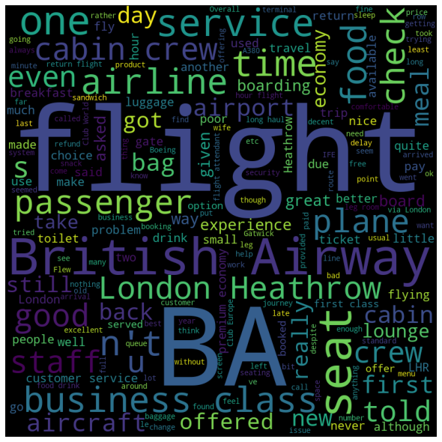
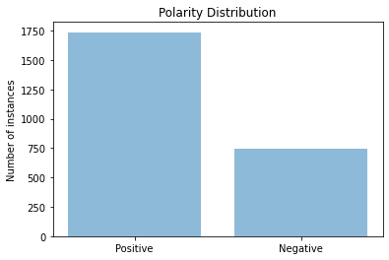
KEY INSIGHTS:
About 70% of the reviews analysed had a positive polarity (positive reviews)
About 30% of the reviews analysed had a positive polarity (positive reviews)
From the popular city in the reviews is London as shown in the word cloud

